Slide 1

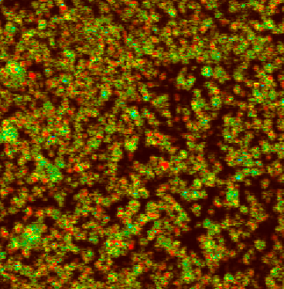
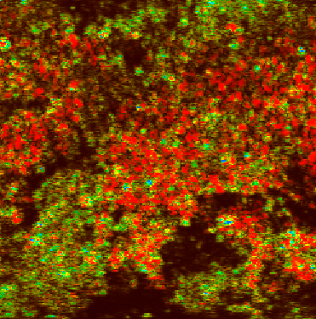
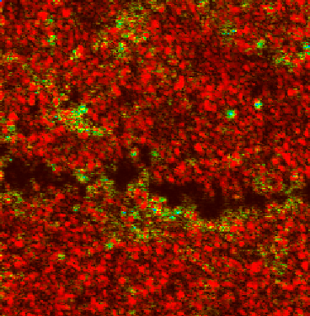
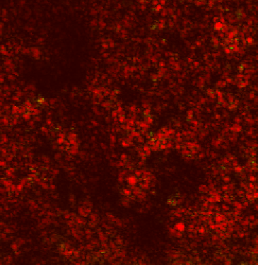
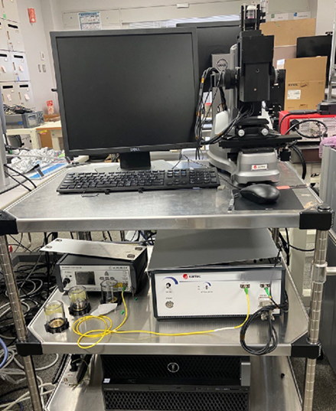
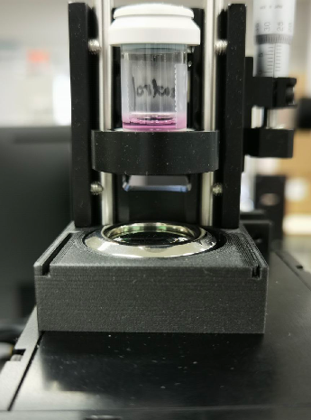
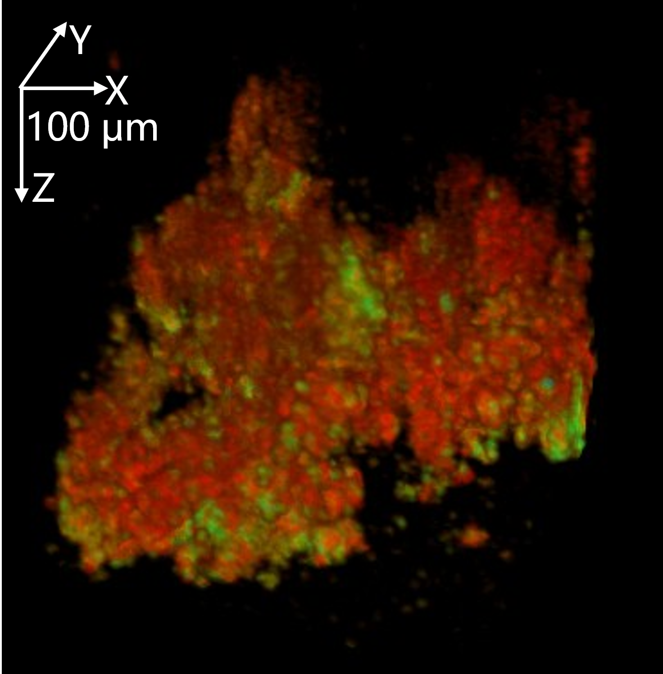


Label-free three-dimensional cellular viability assay using optical coherence tomography
Lida Zhu^{1*}, Oliver Harriman¹, Andy Atsushi Morosawa¹
¹⁾Santec LIS, Komaki, Japan
*lida.zhu@santec.com
Background
subsample using the cassette for NC analysis. Each subsample was measured four times.
OCT measurements followed after a period of sedimentation for 7 minutes. Four OCT measurements were performed at similar locations.
To assess Sensitivity to viability, both NC and OCT measurements were conducted every 30 minutes during the heat treatment. To assess Linearity of measurement, subsamples with mixture ratio of 0%, 25%, 50%, 75%, and 100% of viable cells were measured by NC and OCT.
Cell therapy, boosted by recent advances in culture technology, has emerged as a promising approach for repairing damaged tissues and curing diseases. Viability measurement is a critical quality control step in cell therapy manufacturing to ensure the used cells are viable and functional for therapeutic purposes. However, traditional gold-standard methods, such as trypan blue and fluorescent staining, require labeling and pose contamination risks. Therefore, a label-free and viability-sensitive detection method is desired by pharmaceutical and biomedical researchers.
Optical coherence tomography (OCT) has gained attention in biological imaging due to its non-invasive, high-resolution, and three-dimensional (3D) imaging capabilities. Recent studies have demonstrated its potential for assessing viability of tissue and organoids, suggesting its potential for cell-based applications.
In this study, we propose a label-free approach to estimate cellular viability using OCT. Unlike traditional methods, this approach is purely optical-based detection through the vial, hence has minimal contamination risk.
Results
0-min
60-min
120-min
150-min
Methods
Y
100 μm
OCT utilizes low-coherence interferometry to visualize 3D structure of samples by detecting back scattered light from within biological samples. The nature of coherence detection empowers it with high sensitivity to the local refractive index change caused by the intracellular metabolic activities. By analyzing temporal fluctuations of OCT signal, we aimed to distinguish viable from non-viable cells.
Spectrometer
X
Camera
Sample
En-face OCT images of heat-treated cells over time show a decreasing viable area (yellow to green) and an expanding non-viable region (red). The whole cell region turns to red at 150-min.
Grating
Coupler
Scanner
100
OCT
100
80
NC
80
Light source
Interferometer
Reference arm
60
60
Logarithmic intensity variance (LIV) algorithm was used to quantify the temporal fluctuation magnitude of the OCT signal sequence. In this study, we employed a modified LIV (mLIV) by diving the standard LIV by the maximum signal intensity within a defined time window. This modification combines the temporal feature with signal intensity, mitigating the contrast loss due to the signal-to-noise ratio (SNR) discrepancy by the limited depth of focus. An empirical threshold of 0.056 on the mLIV was used to classify pixel-level viability. The impact of thresholding to the quantification is discussed later.
Viability was quantified as the proportion of pixels with mLIV value above the threshold within the segmented cell region, which was defined via signal-intensity-based masking. Suspended cells and low-SNR regions were manually excluded to ensure accuracy.
For visualization, each spatial pixel’s mLIV was encoded as hue, signal intensity as value, and saturation was set to 1 in HSV color space. In the resulting 3D images, yellow to green regions may represent viable cells, while red may indicate non-viable areas.
NucleoCounter (NC-200, ChemoMetec, Denmark), in short as NC, was used as a reference. It is a gold-standard fluorescence-based viability assay, using a special cassette to extract a small volume of the sample and employing fluorescence staining to count the viability.
Viability (%)
Viability (%)
40
40
20
20
0
0
30
60
90
120
150
0
0
25
50
75
100
Time by heat shock (min)
Viable cell mixture (%)
(Left) Both OCT and NC indicate a consistent decrease in viability over time. OCT showed higher viability than NC in early time points (0-30 min), but lower viability at later stages (90-150 min). (Right) OCT demonstrated good linearity across the five mixture ratios. On the other hand, NC shows low linearity which may have resulted from inconsistent vortexing, especially in the presence of aggregated cells.
These findings suggest that OCT can provide sensitive and label-free measurements of cellular viability in comparison with NC. This approach demonstrates strong potential for manufacturing and preclinical workflows where it is preferable not to open the culture vessel.
Discussions
Threshold optimization：
The viability threshold can directly impact the viability estimation by OCT. We tested several thresholds (examples of current threshold +25% and -25% are shown on the right) across all datasets, finding consistent decreasing tendency of viability. The threshold implemented in this study was selected to best match the readouts of NC. This degree of flexibility allows users to optimize the protocol based on their specific measurement and sample conditions, which is not available in conventional assays.
100
OCT (-25%)
OCT
80
OCT (+25%)
60
NC
Viability (%)
40
Wavelength:
840$±$80 nm
Resolutions:
2.9 μm (axial)
5.8 μm (lateral)
Depth of focus:
360 μm (in air)
1
20
mLIV (dB)
Viable
0
0
30
60
90
120
150
0
Dead
Time by heat shock (min)
-5
10
Robustness to aggregation:
Aggregated cells were observed in both viable and non-viable samples. Due to our gentle mixing protocol, cells were not substantially disaggregated and potentially not evenly subsampled by the cassette for NC measurements. This might have led to the low linearity seen in the NC results. In this situation, the OCT technique possibly had an advantage in that it could image a more representative sample of the cells including those deep within large aggregates.
Aggregated cells were observed in both viable and non-viable samples, posing challenges for effective mixing in NC measurements. NC relies on subsampling from monodisperse cell suspensions for accurate viability assay and therefore is inherently sensitive to such errors. Imperfect mixing with residual aggregation can result in unrepresentative subsamples, likely contributing to the low linearity and high variance seen in NC results.
In contrast, OCT is label-free and capable of acquiring 3D images, making it potentially high-throughput and suitable for assessing a larger and more representative portion of the cell population. This makes OCT potentially robust to aggregation, less prone to sampling variability, and better measurement consistency.
Limitations and future work：
While OCT can analyze dense sediments up to hundreds of microns deep, suspended cells may also be captured whose temporal speckle pattern is contributed to by multiple phenomena hence may not necessarily reflect their viability. Excluding suspending cells is necessary to assure the accuracy of viability assay by OCT. In this study, we manually selected depth ranges (40-100 μm) to exclude suspended cells. Centrifugation may help settle more cells and further improve the measurement accuracy.
This proof-of-concept study used only one cell type and a single viability-reduction method (heat shock). Future work will expand the approach to other cell types and viability-altering mechanisms to validate versatility.
Intensity (dB)
(Left) The OCT light probed invertedly through the bottom of the vial to capture the sedimented cells for analysis. (Right) A representative 3D image of a viable (25%) and non-viable (75%) mixture of Jurkat cells. In this study, the lateral scanning area was 500 x 500 μm² sampled by 256 x 256 locations. At each slow scan location 16 frames were repeated to capture sequential signals of the sample, whose time window was 0.3 s. The A-line rate was 20 kHz, frame rate was 50 FPS, and a volumetric acquisition took 70 s.
Experiment protocols
Sample preparations:
Jurkat cells (JKT-beta-del, JCRB0147, JCRB, Japan) were used to validate the proposed method. The cells were thawed at 37℃ and suspended in RPMI 1640 medium. Half of the sample was heat-treated at 55℃ for 150 minutes to reduce viability. After that, the treated and untreated cells were mixed to create five subsamples with varying viability levels made by different mixture ratios. All subsamples were transferred to AT-closed vials (Aseptic Technologies, Belgium) for measurements.
Measurement protocols:
NC measurements were performed first. The vials were vortexed gently before extracting a

